Slide 1
Anime:
Does more episodes mean better ratings?
Najé Gray
Eco 590
Dr. Kaltenberg

Slide 2
Motivation
Some animes are notoriously long yet have die-hard fanbases
Some animes get cancelled after a single season but are regarded as some of the best
I wondered if length was at all a contributing factor this

Slide 3
Research Questions
How does the number of episodes an anime has affect viewer rating and furthermore, does this change when accounting for only tv animes?
How does the era of time the anime came out affect rating as well?

Slide 4
Key Variables
Dependent variable: score (user rating)
Independent variable: episodes
Controls: members, year, type

Slide 5

Data Collection
-Data was simple to work with just a list of variables with each anime: 20 per page
-Performing a simple for loop to go through all the pages and gather the data from it took around 20 minutes
- Needed to use extend instead of append since data would be in blocks of 20 instead of individual lines that I could add to a data set

Slide 6
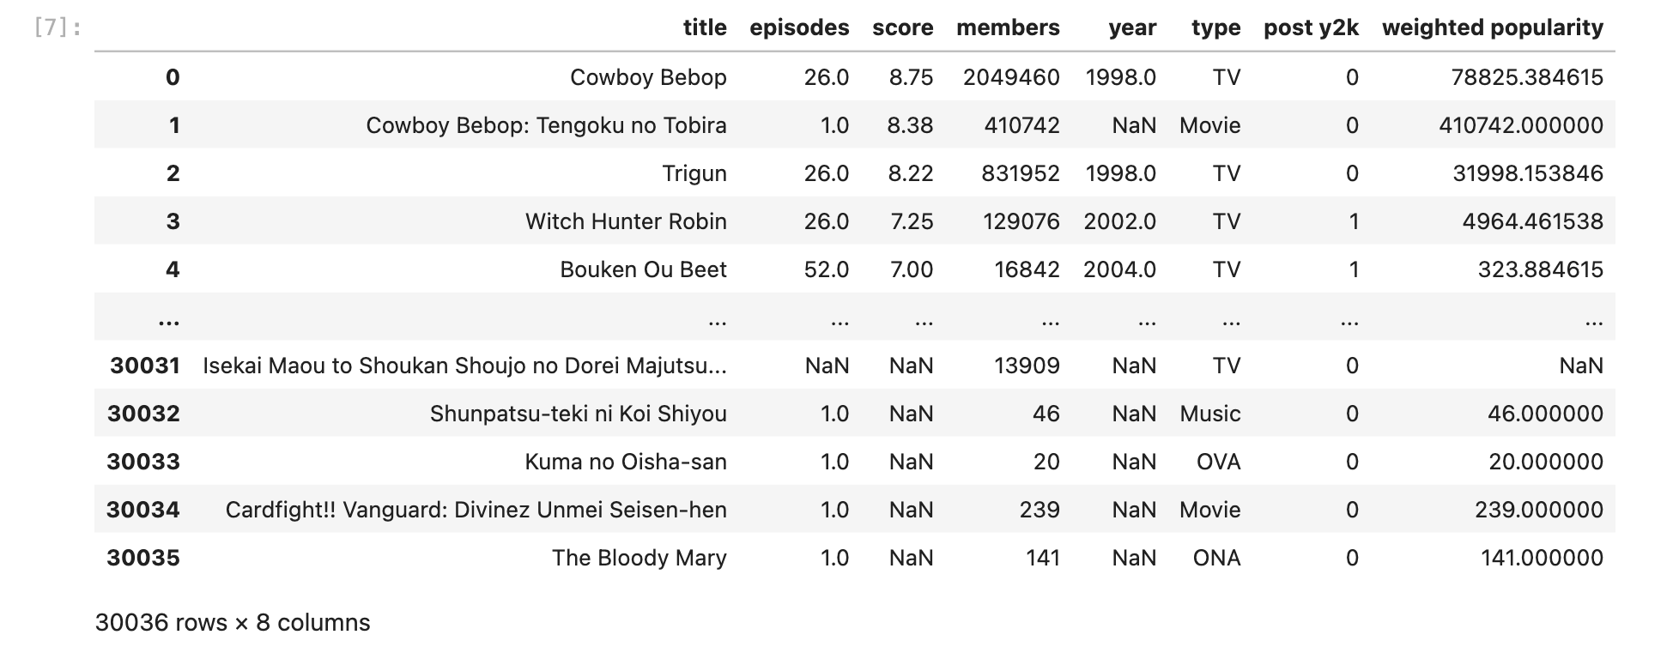
Data Collected
Created Variables: post y2k - Binary Variable that is a 1 if the anime was released during 2000 or later and a 0 if it was released beforehand
weighted popularity - Members/Episodes

Slide 7

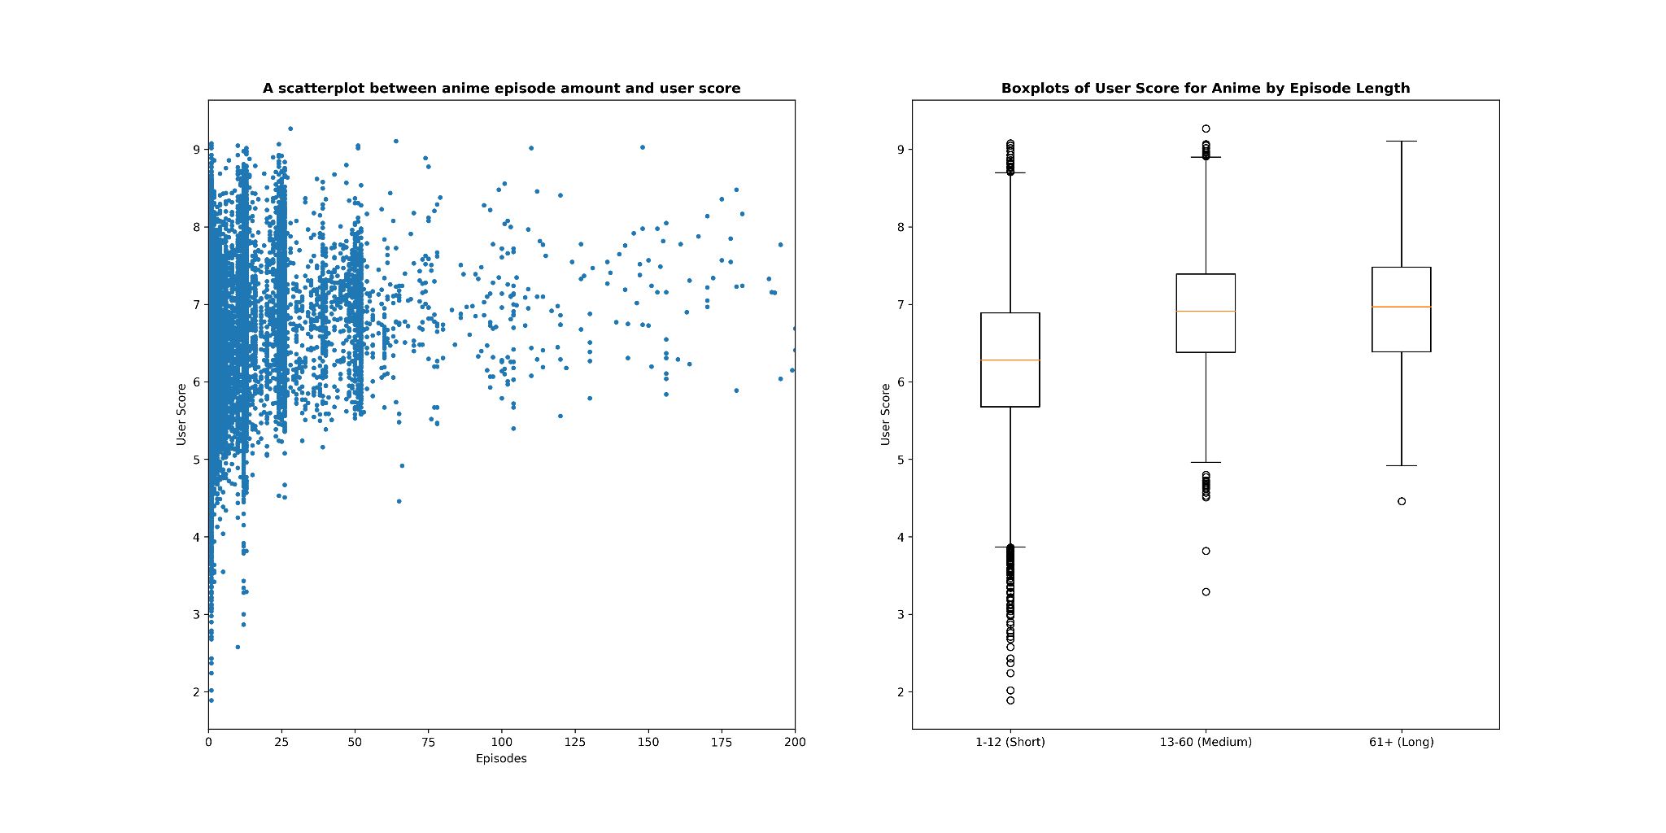
Graphs
The shorter animes seem to have a lot of variance and are on average have less score than the other ones. The medium length and the longer animes are relatively the same score and have similar variance.

Slide 8
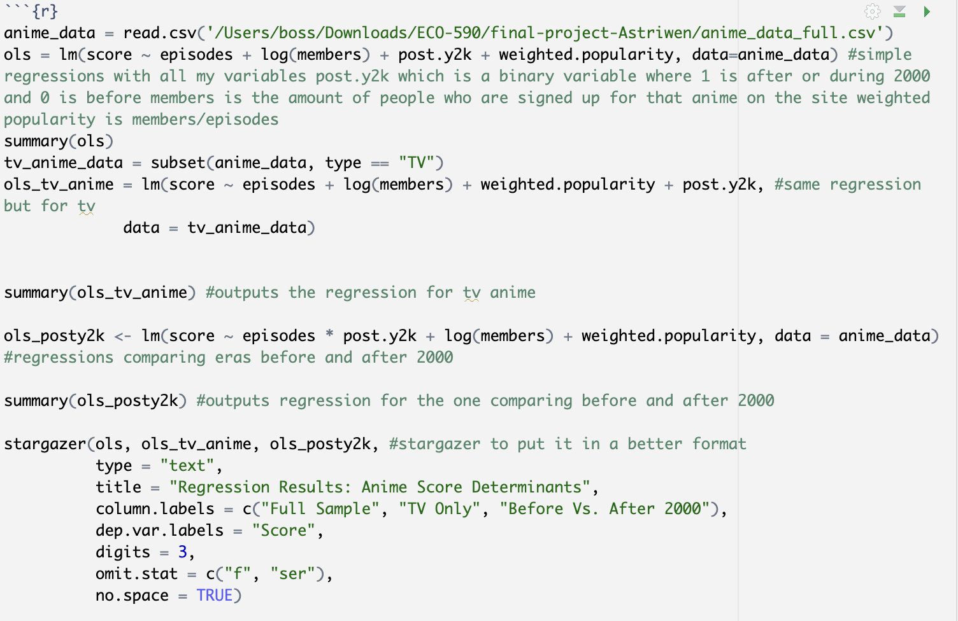
Regression Code
Here I made 3 regressions: one with the full sample, one for tv only, and another that compares the post 2000 vs pre 2000 eras to see which one was rated better.

Slide 9
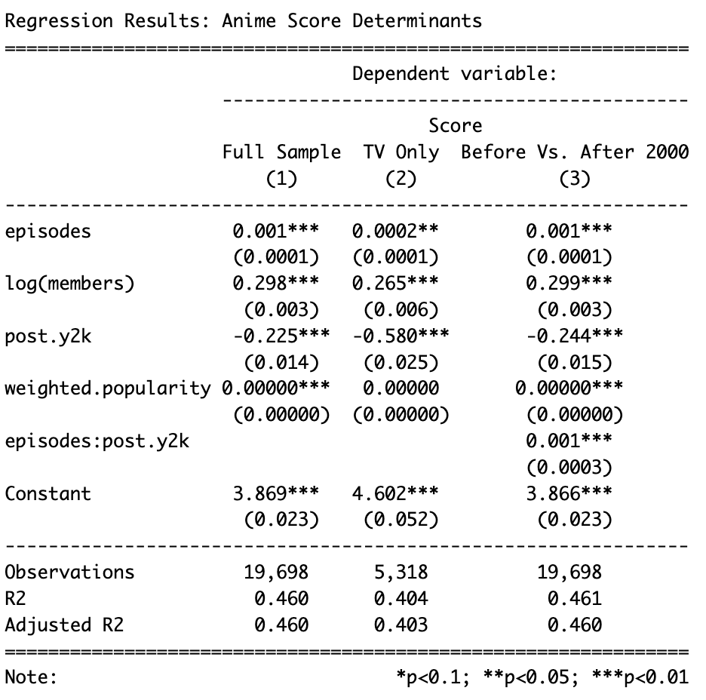
Regression Results
The TV Only sample and the comparing era regressions are statistically significant but the full sample isn’t. Interesting things variables to look at are for TV Only and Before Vs. After 2000 are: log(members), post.y2k, and episodes.

Slide 10
Interpretation for TV-only
log(members) ≈ 0.27: Strong positive effect — more popular TV anime get higher scores.
episodes ≈ 0.0002: Very small positive effect on score within TV anime.
post.y2k TV-only ≈ -0.58: TV anime post-2000 score significantly lower on average than pre-2000 TV anime.
episodes × post.y2k (≈ 0.001): After 2000, longer TV anime are rewarded more in ratings than before 2000.

Slide 11
Interpretation for Before Vs. After 2000
log(members) ≈ 0.30: Strong positive relationship between popularity and score across both periods.
episodes ≈ 0.001: Slight positive effect on score overall.
post.y2k ≈ -0.22: After 2000, anime have lower scores on average compared to before 2000.
episodes × post.y2k ≈ 0.001: Post-2000 anime show a stronger positive effect of episode count on score.

Slide 12
Conclusion
Amount of episodes does have a positive relationship with score but it’s very small
After 2000, anime generally tends to receive lower scores.
After 2000, animes get more positive ratings per episode than before 2000
Anime popularity is a significant predictor of how it is rated
Weighted popularity doesn’t seem to be a very important factor in how an anime is rated

